Slide 1
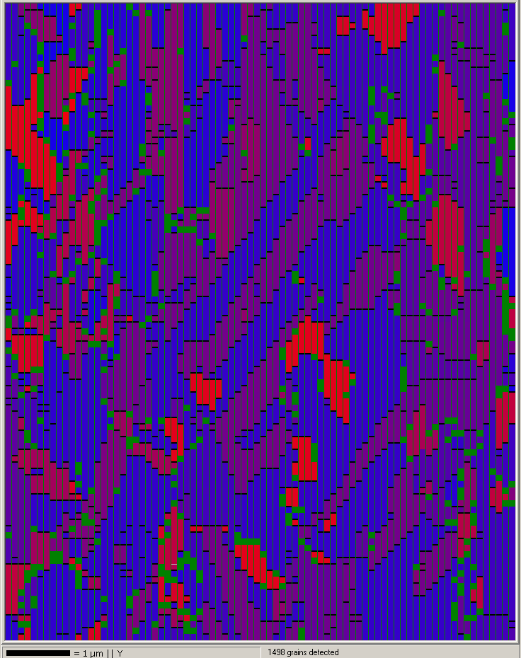
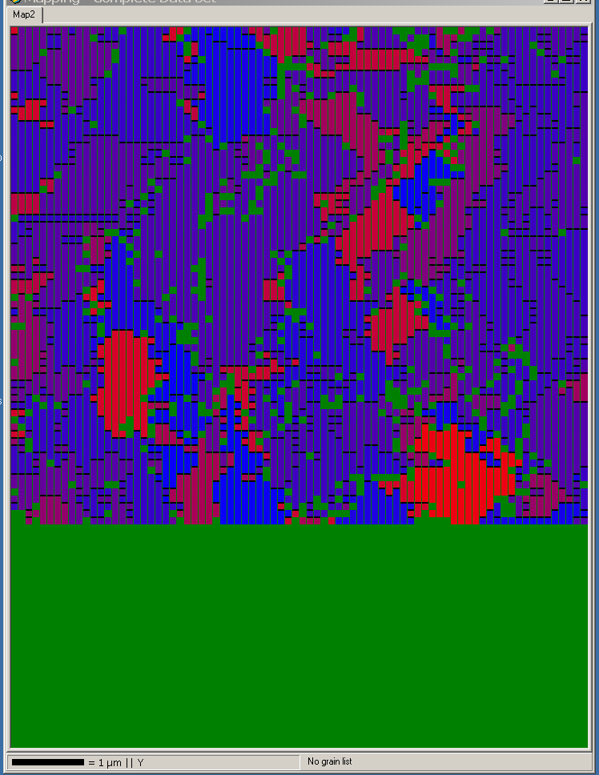
Electroplated Cu
Unmilled
Ion milled for 75 minutes

